Slide 1
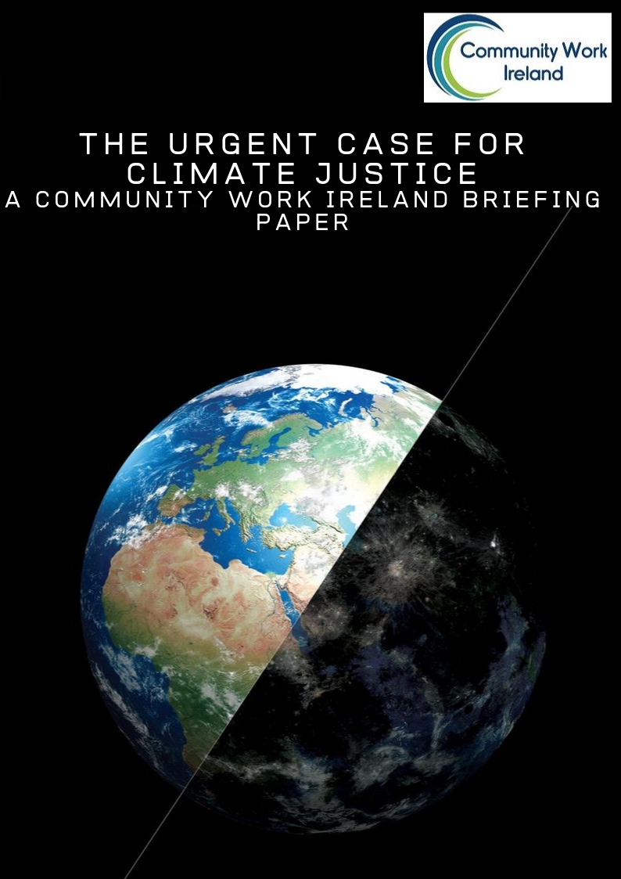
Community Actions For Climate Justice
Ann Irwin, CWI National Co-ordinator
Saturday, January 25th 2020
National Opera House, Wexford

Slide 2
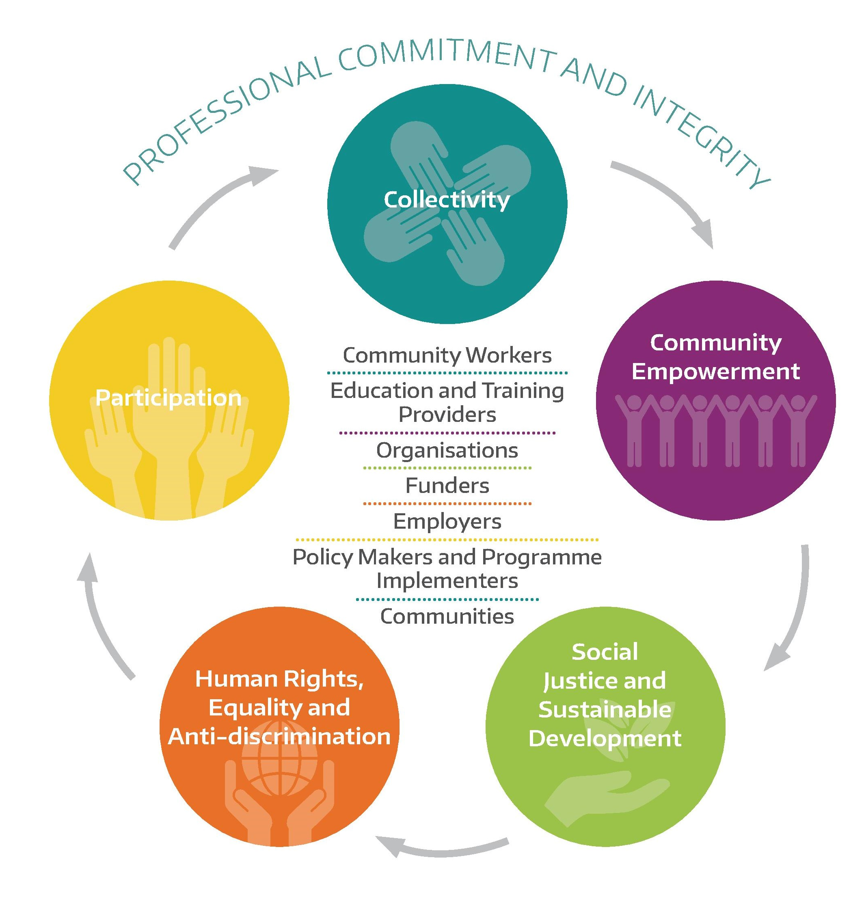
Community Work Ireland
a membership organisation that seeks to support and promote community work as a means of addressing poverty, social exclusion and inequality.
Community Work
is a value-based approach that is a developmental activity comprised of both a task and a process. The task is social change to achieve equality, social justice and human rights, and the process is the application of principles of participation, empowerment and collective decision making in a structured and co-ordinated way

Slide 3
Towards Climate Justice
In 2012, CWI (then the Community Workers’ Co-operative) published Towards Climate Justice: A strategy guide for the community sector in responding to climate change.
Funded by the EPA, launched by Professor John Sweeney and with a foreword from Mary Robinson, the report was designed as a resource to build engagement between the community sector and the issue of climate change.

Slide 4
CWI Work Now
Demand from CWI members
  Briefing Paper
  Initial seminar in October
  CWI Climate Justice Working Group established
Sustainable, Inclusive and Empowered Communities: A five-year strategy to support the community and voluntary sector in Ireland 2019-2014 launched by DRCD. Objective 11 in the strategy - Linking with the Government’s Climate Action Plan 2019
    provide training and capacity building in relation to Climate Change to community development and local development organisations,
    pilot and develop models of good practice on Climate Change adaptation and mitigation at community level, and
    include a focus on Climate Change in all community development and local development programmes and initiatives.

Slide 5
Challenge
For many in marginalised communities climate is not on their agenda.
These communities are Travellers, migrants, socioeconomically disadvantaged communities and others
…..more concerned with preventing homelessness, mental health and wellbeing, avoiding food poverty and ensuring their children stay in education.
Ironically, these are the very communities that are likely to be most affected by climate change and have the least ability to respond.
The challenge is to see how the two agendas can be brought closer together?

Slide 6
Briefing Paper
Current Irish and International Policy
Progress to date
A just and equitable transition – key issues for community development
Why should community workers be engaged & what can they do?
  Consciousness raising and education
  Collective action addressing systemic pollution
  Supporting sustainable alternatives

Slide 7

Current Irish and International Policy
International response to the climate crisis - 2015 UN Paris Agreement
Citizens’ Assembly
National Dialogue for Climate Action Recommendations of the Citizens’ Assembly on Climate Change
Climate Action Plan to Tackle Climate Breakdown – a missed opportunity?

Slide 8

Progress
Currently, Ireland is far off course in relation to achieving the existing targets for 2020 and 2030, and on both of the global climate governance principles, ambition and equity, Ireland is significantly failing, currently ranking second-worst in the EU.

Slide 9

A just and equitable transition
Key concern for Community Work Ireland and our members
Environmental justice - ‘no less than a decent environment for all, with no more than our fair share of the earth’s resources’
Environmental justice considers the social and political drivers and implications of pollution
Calls attention to the ways in which different groups and communities experience environmental burdens (such as pollution or fuel poverty) or enjoy environmental benefits (such as access to green space and fresh, local food).
Guided by environmental justice and the principles and values of community development, Community Work Ireland calls for the development of policies and programmes that support and promote community work and human rights approaches to climate action

Slide 10
Why should community workers be engaged & what can they do?
Inherent in the climate crisis and our societal responses is the issue of social justice and equity.
Marginalised communities and groups in Ireland and globally will bear the brunt of the impacts of climate change and have the least resources to adapt and make the necessary transition to a zero-carbon society. This is a collective challenge requiring structural change across Irish society and globally.
Yet the dominant conceptualisation of environmental issues in policy tends to focus on individual actions and consumer choices such as buying organic products or electric vehicles and making our homes more energy efficient.
As well as unfairly burdening marginalised communities and groups, this individualising of environmental action can feel disempowering and futile given the scale of the challenge.
Community work principles and methods offer an important means of responding to the climate crisis in a collective way which is commensurate with the challenge and which places social justice and human rights at the centre of climate action.

Slide 11
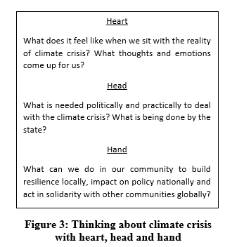

Consciousness raising
Community workers can play an important role by opening up space for dialogue about the climate crisis.
Practitioners do not need to be experts in climate science but instead facilitators of a participatory consciousness raising process guided by community work values and methods, such as popular education.

Slide 12
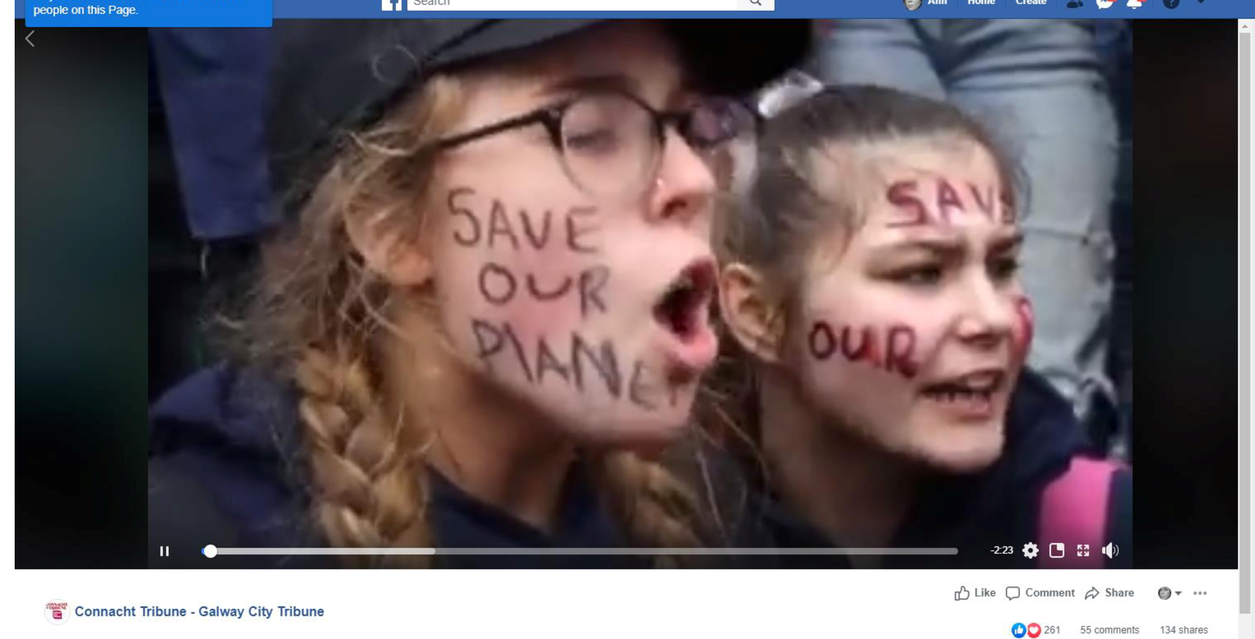
Collective action
. School strikers and Extinction Rebellion illustrate the power and importance of collective action in holding states to account and creating a mandate for action.
Community workers can play an essential role in supporting those they work with to engage as appropriate with mobilisations for climate justice and ensure that the concerns and perspectives of marginalised communities and groups are central to campaign demands.

Slide 13


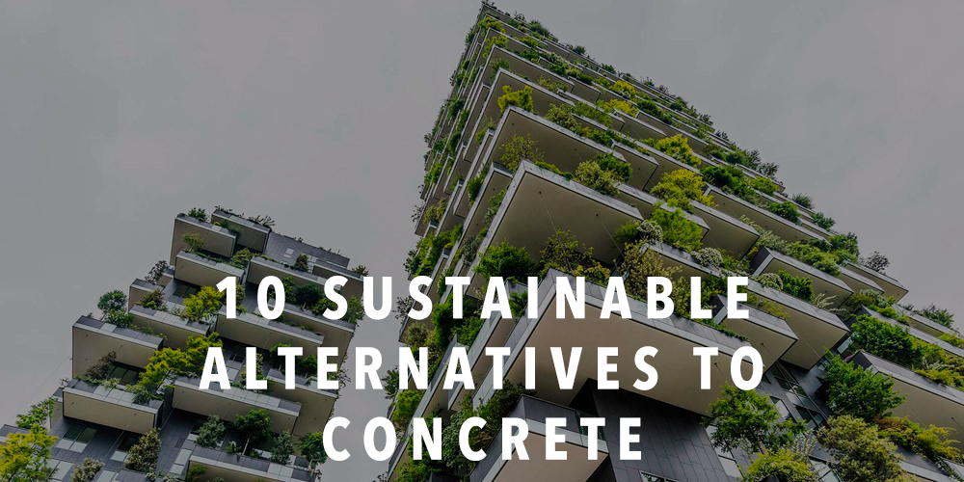
Supporting sustainable alternatives
Many of the positive solutions to the climate crisis involve building sustainable and resilient local economies, energy systems and food systems.
  Join the SEAI Sustainable Energy Communities programme
  Establish allotments or a community garden
Bring equality and inclusion focus and skills such as group work and organisational development.

Slide 14

Policy, Networking & Alliances
Use the work on the ground to influence policy
Ensure that policy is literate and conscious of how it affects your community
Build alliances with environmentalists and environmental groups and network – locally, regionally, nationally and internationally

Slide 15
Conclusion
Community workers and the community work sector is in a unique position both to support responses to climate change and to ensure that the experience of the most marginalised are represented and included in climate change and sustainable development policy and implementation.
Essential
  Capacity building and the provision of analysis of the current situation in relation to climate change and an analysis of current policy initiatives;
  Encourage community workers to begin or deepen their engagement in climate action;
  Explore the supports that are required for community work approaches to climate action.
It is about acknowledging that community workers do not have to be expert in this area but both sectors – community and environment – need to build alliances and to work together
It is about persuading government that the frameworks need to be developed to facilitate and promote this agenda

Slide 16
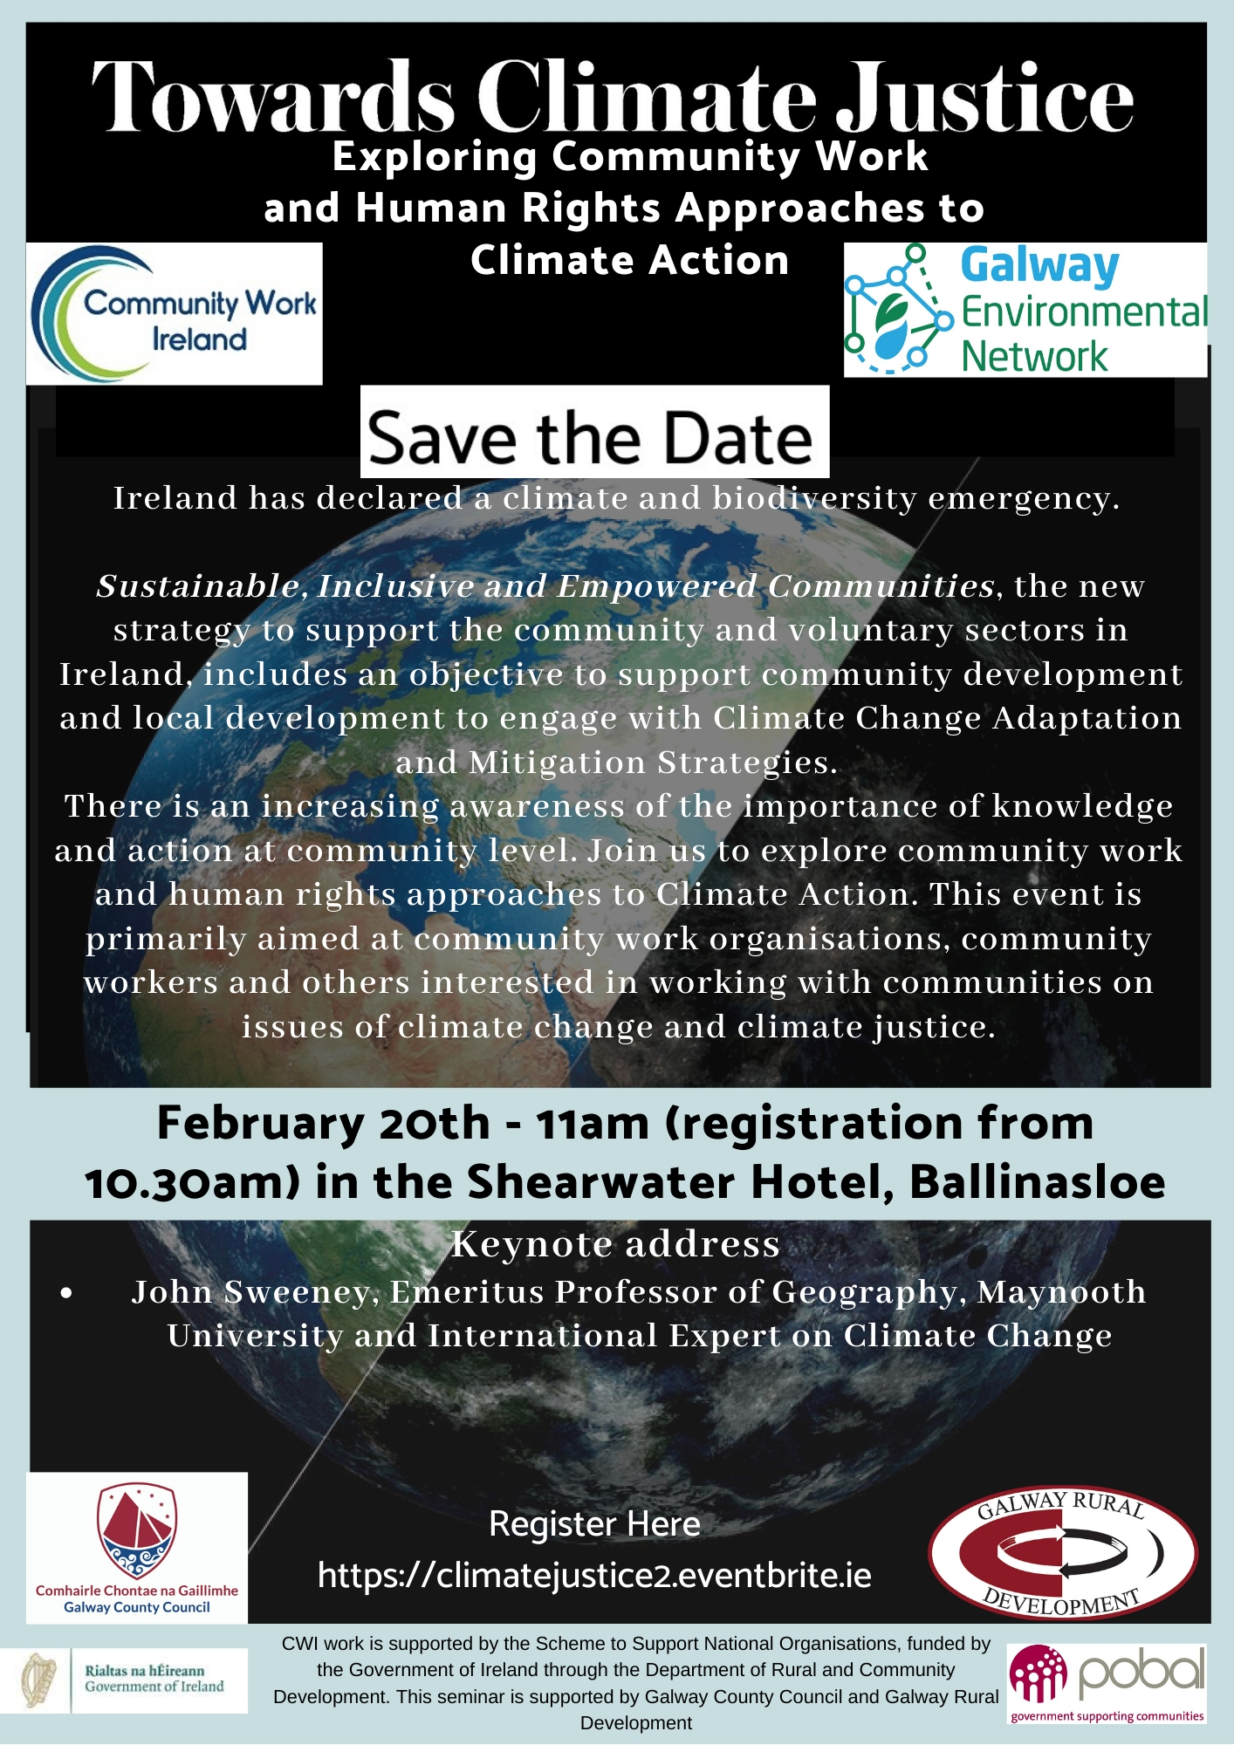

Next Steps
Join Community Work Ireland (its free!!)
Join the CWI Climate Justice Working Group (meetings are over Zoom)
Come to the CWI seminar in February (20th) in Ballinasloe

